Slide 1
CSS - introduction
Viktoras Lava www.viktoraslava.lt

Slide 2
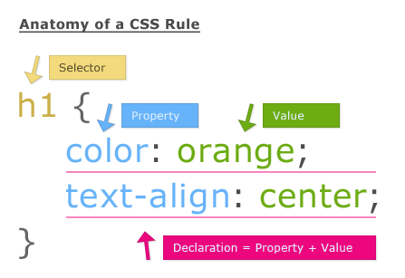
What is CSS?
Cascading Style Sheets (CSS) is a style sheet language used for describing the look and formatting of a document written in a markup language.

Slide 3

CSS history
CSS was first proposed by Håkon Wium Lie on October 10, 1994. At the time, Lie was working with Tim Berners-Lee at CERN. CSS was developed to provide style sheets for the web.

Slide 4
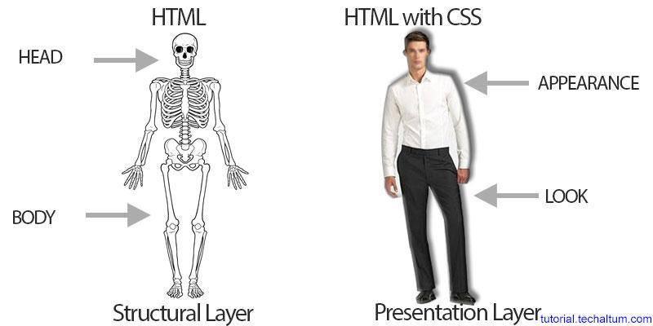
HTML vs CSS

Slide 5

Types of CSS
There are 3 ways of writing your CSS styles:
Internal (styles placed in HTML file)
Inline (styles place inside HTML tag)
External (styles placed in seperate CSS file)

Slide 6
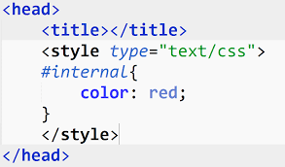
Internal CSS
CSS Code is written inside <style> tag in head. Recommended for single page only.

Slide 7
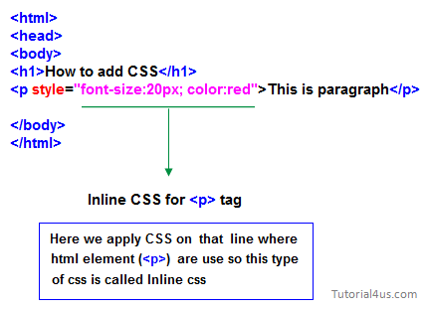
Inline CSS
CSS code is written inside html tag directly, in style attribute. Try to avoid this kind of styles, this is mostly used with PHP.

Slide 8
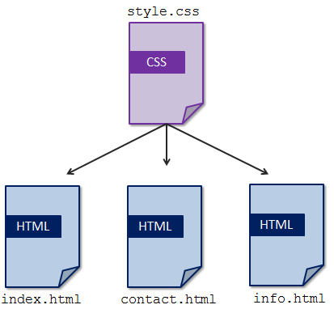
External CSS
CSS code is written in separate file with .css extension and <link> element is used to attach external css with html document. Used for multipage websites. This is how you should write your CSS styles.
CSS code is written in separate file with .css extension and <link> element is used to attach external css with html document. Used for multipage websites. This is how you should write your CSS styles.

Slide 9
Questions?

Slide 10
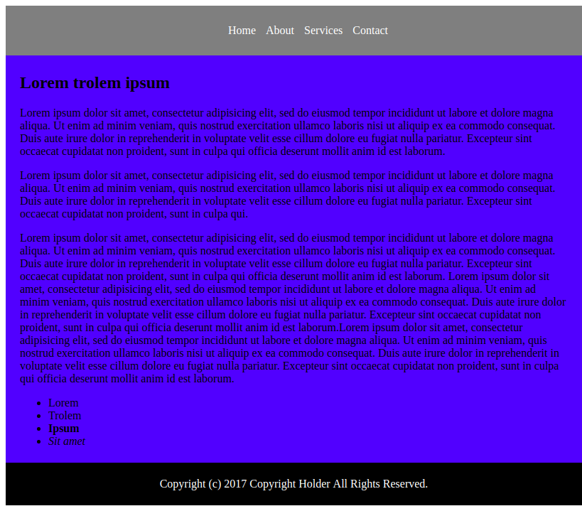
Homework
Read about main semantic tags at html5doctor.com/element-index/ (Tag list is on “Main semantic tags” slide)
Do the homework task. Use semantic tags, external styles, class selectors (ex. “.navigation”)
CodePen example

